Slide 1

MGT 689
Organizational Strategy, Structure, and Effectiveness
Professor: Dr. Zvi Aronson

Slide 2
Objectives
Organization Strategy and model examples
Organizational Structure and its Dimensions
Contrast mechanistic and organic design forms.

Slide 3
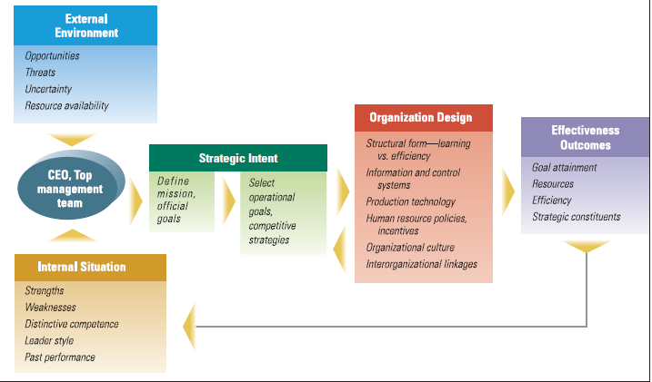
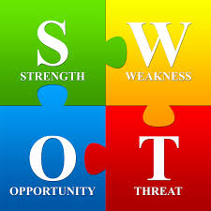

Top Management Role in Organization Direction, Design, and Effectiveness
Organizational goal - a desired state of affairs that an organization attempts to reach
Organic –innovation
Mechanistic - efficiency
Instagram
Capture and share the world’s moments
Notes:
Organic
Mechanistic

Slide 4
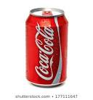
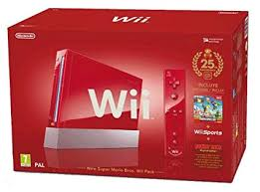
Organizational Purpose
Strategic intent - organization’s energies and resources are directed toward a focused, unifying, and compelling firm goal
Mission
Competitive Advantage
Core Competencies
Operating Goals
Performance
Resources
Market
Employee
Development
Innovation and
Change
Productivity
The distinctive attribute(s) of an organization that enables it to outperform its competitors.
To put a coke within arm’s
reach of every consumer
in the world
Based on SWOT : Created a gaming system low on graphics but hi on interaction – vs Microsoft; Sony
Nintendo
Notes:
The core competence provides a competitive edge.

Slide 5
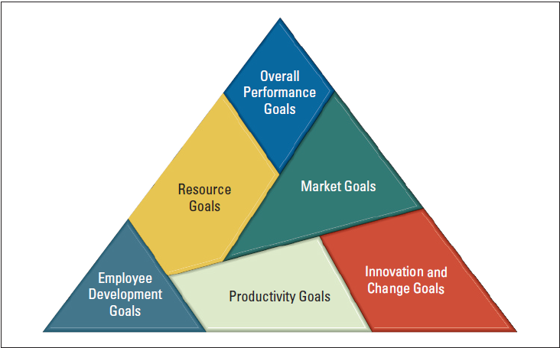

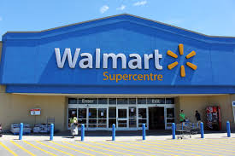
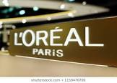
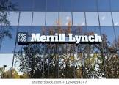

Organizational Operating Goals
More specific measurable outcomes – provide direction for day to day decisions
Delivery of packages
Hire every veteran who
wants a job
Double its clientele
NPD products;
services
Juniors work
on various
projects

Slide 6
Why Do Managers Need to Plan?
Reduce the impact of change
Minimize overlapping and waste
Set standards to facilitate control
Provide Direction
Uncertainty
Meta goal
Coordination
Monitoring
Notes:
Managers should plan for at least four reasons.

Slide 7


What Are Some Criticisms of Formal Planning?
Formal planning can’t replace intuition and creativity…
May create rigidity…
Locked into
Specific
goals
Schedule
Mismatch for R&D
Managers often loose sight of the future…
Notes:
Although it makes sense for an organization to establish goals, an overall plan and direction, critics have challenged some of the basic assumptions of planning.
Planning Reduces vision to a routine, so Planning time to innovate is important

Slide 8
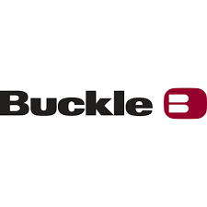
Strategic Management
Strategic Management
What managers do to develop an organization’s strategies
Strategies
The action plan for achieving an organization’s goals (e.g., how it will compete successfully; how it will attract its customers; Buckle; B & H)
Strategic Management Process
A six-step process that encompasses strategy planning, implementation, and evaluation
Notes:
Strategic management is what managers do to develop an organization’s strategies. What are an organization’s strategies? They’re the plans for how the organization will do what it’s in business to do, how it will compete successfully, and how it will attract and satisfy its customers in order to achieve its goals

Slide 9
The Strategic Management Process
Identify mission, goals and strategies
SWOT
External Analysis
Internal Analysis
Formulate Strategies
Implement Strategies
Facebook ?
Give people power
to stay …connected
Evaluate Results

Slide 10
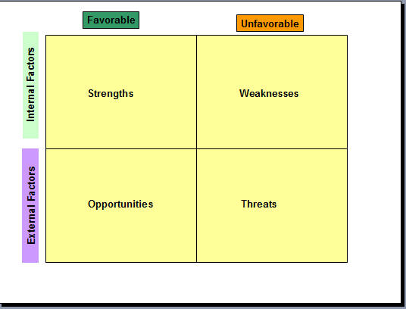
What is a SWOT Analysis?
Formulating a strategy
Notes:
The combined external and internal analyses are called the SWOT analysis because it’s an analysis of the organization’s strengths, weaknesses, opportunities, and threats. Formulating a strategy

Slide 11
Selecting Strategy and Design
A strategy is a plan for interacting with the competitive environment
Managers must select specific strategy design
Models exist to aid in formulating strategy:
Porter’s Five Forces
Miles and Snow’s Strategy Typology
Choosing if the firm will perform different activities than the competitors
Or similar activities more efficiently ➔

Slide 12
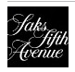
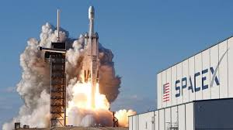

Porter’s Competitive Strategies
Managers can make a firm more profitable by adopting one of two strategies.
Differentiation strategy – to distinguish products or services from others in the industry
Low-Cost Leadership – increase market share by keeping costs low compared to competitors
Low cost access to space
Organizations may choose to
focus on multiple markets or a more narrow focus

Slide 13
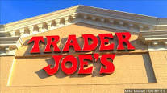
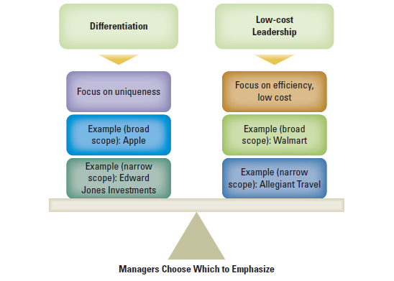
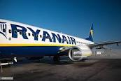
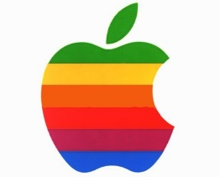
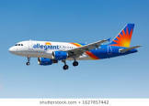

Porter’s Competitive Strategies
Innovative, high
quality, health
conscious food
Cheap tickets vs
customer care
Requires: Creative employees,
provided with the time and resources
to seek innovations
No frills,
old planes
Market: little
cities in USA
Narrow Market:
Rural, small
town USA

Slide 14
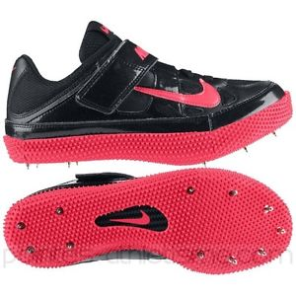
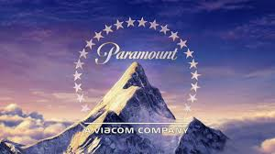


Miles and Snow’s Strategy Typology
Managers should seek to formulate a strategy that
matches the demands of the external environment
Nike’s differentiation
strategy: Provides unique products, e.g., cutting-edge
designs for its shoes
Prospector
Learning orientation; flexible, fluid, decentralized structure
Values creativity, risk-taking, and innovation
Defender
Efficiency orientation; centralized authority and tight cost control
Emphasis on production efficiency, low overhead
Analyzer (middle)
Balances efficiency (to retain customers) and learning; tight cost control with flexibility and adaptability
Emphasis on creativity, research, risk-taking for innovation
Reactor
No clear organizational approach; may shift
abruptly depending on current needs (ad-hoc)
Reliable hits; few blockbuster risks; holds on to current customers
Defend core bus: selling books; goods, then build bus., e.g., online streaming; (iTunes)
Nook: Competed well with Amazon; The multifunction device - a challenge (iPad)

Slide 15
How Strategy Affects Organization Design
Managers must design the organization to support the firm’s competitive strategy
Strategy impacts internal organization characteristics

Slide 16
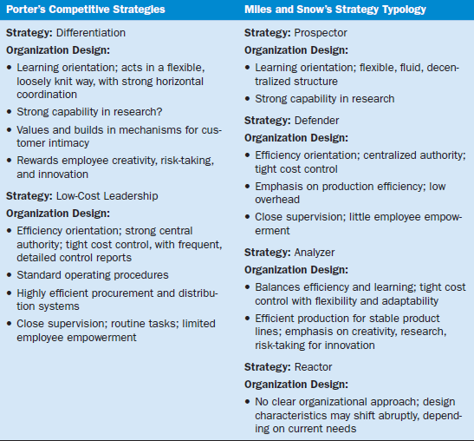
Organization Design Outcomes of Strategy
-How MGT create organizational structure
-What design features ?
-How to organize jobs ?

Slide 17

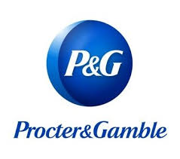
Structure Dimensions
Specialization
Dividing work activities into separate job tasks
(operating room; MD)
Formalization
How standardized an organization’s jobs are and the extent to which employee behavior is guided by rules and procedures( Universities; predictability ?)
Centralization
The degree to which decision making takes place at upper levels of the organization
Decentralization
The degree to which lower-level managers provide input or actually make decisions (empower; effect their work)
Complexity
1.Vertical - number of levels in the hierarchy
2.Horizontal –number of departments or specialties that exist across the firm
3. Spatial – the degree organizational departments and personnel are dispersed geographically
Small groups make NPD
decisions
Notes:
Formalization refers to how standardized an organization’s jobs are and the extent to which employee behavior is guided by rules
and procedures.
At P&G small groups are empowered to make NPD decisions, when has led to an increase in products ready for market.
Centralization is the degree to which decision making takes place at upper levels of the organization. Decentralization is the degree to which lower-level managers provide input or actually make decisions.

Slide 18
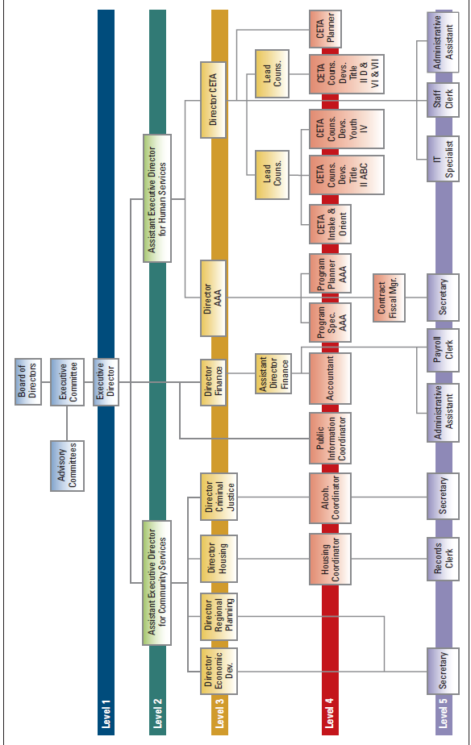
Organization Chart
Vertical complexity – 5
Horizontal complexity – 7 departments at level 3
Spatial complexity – 1 – offices all in one location
Project teams
➔

Slide 19
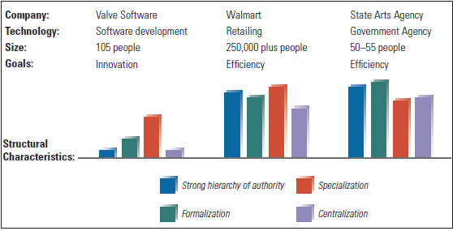
Differing Characteristics of Three Organizations
Span of control (wide?)

Slide 20


Departmentalization
Once jobs have been divided through work specialization, they must be grouped
Departmentalization refers to how jobs are clustered together.
There are several key kinds of departmentalization (unique class):
Functional Departmentalization (e.g., eng., acct., HR; skills-based)
Product Departmentalization (Nike; SM authority)
Customer Departmentalization (AL)
Geographic Departmentalization (CC)
Process Departmentalization (MV)
Athletic
Casual
Manufacturing
Sales
Cross functional teams?
Notes:
Black and Decker – a manufacturing company
How jobs are grouped together is called departmentalization. There are five common forms of departmentalization although an organization may use its own unique classification. No single method of departmentalization was advocated by the early writers. The method or methods used should reflect the grouping that would best contribute to the attainment of the goals of the organization and the individual units.

Slide 21


Organizational Designs
Small firms ?
Simple Structure
low departmentalization, wide spans of control, authority centralized in a single person, and little formalization (strength?)
Functional Structures
groups similar or related occupational specialties together (Revlon,(R&D))
Product Divisional Structure
made up of separate business units or divisions that are based on product line
Geographic Division Structure
Made up of separate business units or divisions that are based on geographic area served
Matrix Structure
Made up of groups that are managed on at least two different dimensions. (Individuals report to at least two supervisors; F; PM)
Pharmaceutical
Consumer product
Notes:
Most companies start as entrepreneurial ventures using a simple structure, which is an organizational design with low departmentalization, wide spans of control, authority centralized in a single person, and little formalization. The simple structure is most widely used in smaller businesses and its strengths should be obvious. It’s fast, flexible, and inexpensive to maintain, and accountability is clear.

Slide 22
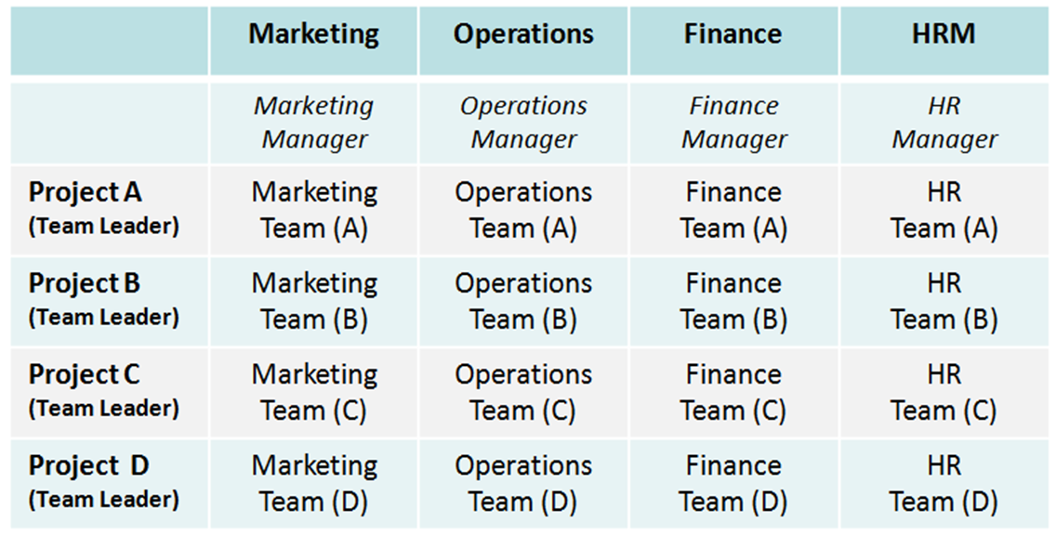
IT Consulting Firm

Slide 23
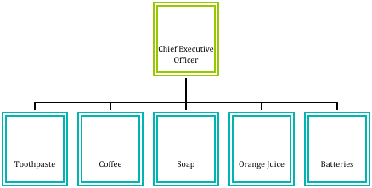
FIRM X

Slide 24


Mechanistic vs. Organic
“Mechanistic” and “Organic” are more generic ways of describing an organizational structure.
Mechanistic organizations are high in specialization, formalization, and centralization
Organic organizations are low in specialization, formalization, and centralization (professionalism; senior engineers., Google).

Slide 25
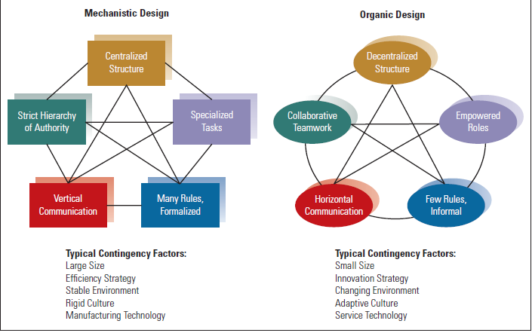
Organic and Mechanistic Designs
(2000)
; RND
Notes:
RND

Slide 26
What Are Various Levels of Strategies?
Corporate Strategy
An organizational strategy that addresses the question “What business(es) should we be in?” This leads to issues related to entering new businesses and exiting businesses. It does NOT address how the businesses will compete and be successful (Pepsico); growth…
Corp
SBU
SBU
SBU
To be the world’s # 1
firm in
food & beverage
Notes:
A corporate strategy is an organizational strategy that specifies what businesses a company is in or wants to be in and what it wants to do with those businesses. It’s based on the mission and goals of the organization and the roles that each business unit of the organization will play

Slide 27


Growth Strategy
Growth Strategy
A corporate strategy in which an organization expands the number of markets served or products offered either through its current business(es) or through new business(es).
Some growth strategies include
Vertical Integration (Backward and Forward Integration; distributor)
Related Diversification(Horizontal Diversification)
Unrelated Diversification
Communication
Energy
Services
Notes:
A growth strategy is when an organization expands the number of markets served or products offered, either through its current business(es) or through new business(es). Because of its growth strategy, an organization may increase revenues, number of employees, or market share. Organizations grow by using concentration, vertical integration, horizontal integration, or diversification

Slide 28
Examples of Corporate Strategy
Forms
Vertical Integration
Related Integration
Unrelated Diversification
AOL buys the stock of Time Warner in what is described as a merger of equals.
Hewlett Packard proposes to buy Compaq Computers.
Phillip Morris buys Miller Brewing to diversify out of the cigarette business.
ACQUISITIONS
Cetus, a leading firm in the biotechnology field, teams up with larger corporations which provide needed capital.
Dow Chemical and Corning Glass create joint venture, more profitable than either parent.
Pfizer and Genentech formed an alliance to market Genentech’s new drug
Means
STRATEGIC
ALLIANCES
STRATEGIC
ALLIANCES
Humana develops a full line of health care services, vertically integrating across businesses.
INTERNAL
DEVELOPMENT
Lockheed to develop a new satellite system to promote growth.
Amazon diversified into cloud computing.

Slide 29
Acme and Omega Collaborative Assignment – See Canvas
Discussion Questions
Using the structural dimensions described in our text (and slides), describe a “mechanistic” organization.
Using the structural dimensions describe an “organic” organization
B. The following questions relate to the case, “Acme and Omega” See Canvas
3. Using the structural dimensions we described, explain why Omega is the higher performer on the prototype contract.
Using the structural dimensions discussed explain why Acme is the higher performer on the final contract.
If you were an organization design consultant, what advice would you give to Jim Rawls of Omega?
We will get input from the teams later on this session. After class, share your collaborative work as a word Docs with zvi.aronson@stevens.edu and I will get back with my feedback.

